Slide 1
OD Estimation from Traffic Count
By Saumya Bhatnagar
MSC – HPC(2017-18)
Department of Mathematics
(April 6th, 2018)

Slide 2
Table Of Content
What is OD Estimation?
Comparison of Estimation approaches
Our approach
Space State Model into Time dependent OD Estimation
Excluding travel time
Considering travel time
Solution Technique
Kalman Filter
Gibbs sampling Scheme Used
Solution Framework
Multiple chain convergence of Gibbs Sampler
Parallel Implementation of the Proposed Algorithm
Speed Ups and Efficiencies
References

Slide 3
What is OD Estimation?
Most crucial in Traffic Planning
specify travel demands between the origin and destination nodes in the network
OD Matrix Estimation: the calculation of OD-matrices using observed link flows
Two types of estimation models:
Time independent, and
Time dependent
We’ll discuss time dependent OD estimation using traffic count.
But first we need to finalize the estimation approach

Slide 4
Comparison of Estimation approaches
One approach: focus on surveillance data => assume the OD matrix
Time consuming
Doesn’t give real time results
AVI: automatic vehicle identification : less survey cost, high installation cost
Another approach: non assignment models
limited traffic surveillance facilities in a real-world network
require considerably large amounts of link flow information for computing the O-D flow;
computationally intensive for real-time implementations in large-scale networks

Slide 5
Our approach
Aforementioned studies assume that the transition matrix is known or at least approximately known, which is unrealistic for a real world network
Kalman Filter = recursive filter, for dynamic system, with incomplete and noisy measurements.
This character is similar to the behavior of traffic
We use State Space Model into time-dependent O-D estimation with the state vector indicating the unknown O-D flows
Prior data is required to identify the parameter matrix
(Gibbs sampler + Kalman filter) in space state models
Computationally intensive sampling
Implement parallel chain convergence control

Slide 6
Space State Model into Time dependent OD Estimation - Excluding travel time
Space State Model (SSM) Assumptions:
The transition matrix is assumed to be fixed
The link travel time is not considered
to estimate path flows from link traffic counts, SSM is coupled with two parts:
Transition equation :
Observation equation :
When considering the travel time, the observation equation is modified,
Here, x_{t} = a p×1 network path flows on time t
F = a p×p path flow transition matrix
u_{t,} v_{t} = iid Gaussian noise terms
y_{t} = a q×1 link traffic observation vector on time t
H = a q×p zero-one matrix which denotes the path-observation incidence matrix

Slide 7


Time dependent O-D estimation with SSM - considering travel time
Major issue in transportation problems/ path flow estimation problems is travel time inclusion
Modified observation equation:
The state variable, x_{t}^{lag} = p (MaxLag+1)×1 matrix composed of series of state vectors (takes the travel time into account)
The term MaxLag denotes the maximum time lag intervals that can be observed on observation sites at time t.
The path-observation incidence matrix, H_{t}, = a zero-one q×p(MaxLag+1) matrix at time t. If the flow of a path can be observed at detector q, then the corresponding element in H_{t} is one; else, it is zero.

Slide 8


Solution Technique
There are two major elements to be incorporated in the solution method,
filtering states by observations, and
sampling scheme of transition matrix, F, and state vector, x.
Both x and F are unobservable, thus KF is not suitable to directly estimate and forecast the state vector => Gibbs sampler
Prediction of state vector can be represent as
After h time periods, is
The prediction can be written as

Slide 9
Kalman filter:
For the linear–quadratic–Gaussian problem,
To estimate a system state when it cannot be measured directly
estimates the instantaneous state of a linear dynamic system with Gaussian noise (the same as our purposed model)
Uses a series of measurements observed over time, containing statistical noise(+ other inaccuracies)
Produces estimates of unknown variables that tend to be more accurate than those based on a single measurement alone, by estimating a joint probability distribution over the variables for each timeframe
The structure of the filter can be derived in a Bayesian framework as follows.
At the first stage (i.e. t=1), there’s no observation exists, thus the state vector x₀ must be generated by a prior distribution that x₀~N(μ₀, V₀), where μ₀ = mean and V₀ = covariance matrix.
Using this the forecast observation would be normal
The next parameters will be updated according to Baye’s rule
The posterior will be normal
Set these variables for the next update

Slide 10
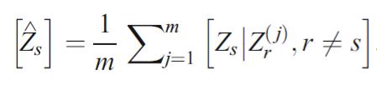
Gibbs Sampling Scheme Used
Gibbs sampler is a technique for generating random variables from a distribution indirectly, without having to calculate the density.
We make the following assumptions,
The initial x₀~N(μ₀, V₀),
The covariance matrix Σ and Γ are known, and
Given F, the distribution x_{t} is Gaussian.
The Gibbs sampling through m replications of the i iterations produces i iid k tuples,
Z_{1j}^{(i)}: Z_{kj}^{(i)}, j=1,2,3,…, m,
which the proposed density estimate for [Z_{s}] having form

Slide 11

Solution Framework
It is an iterative estimation of state vectors and transition matrix.
The above Gibbs sampling scheme on a random transition matrix and state vector forms the center part of the algorithm. In the process of generating state vectors, Kalman filtering mechanism is added.
Multiple chain convergence of Gibbs Sampler
Monitoring the chain that Gibbs sampler produce.
Single chain monitoring can only expose strong non-stationarities, it is more relevant to consider the cumulated sums, and stabilize them for convergence to be achieved.
# Gibbs iterations =g, and the corresponding element x^{(g)} .
The difference between cumulated averages should be less than ɛ,
During the KF stage, transition matrix and mapping matrix are fixed; while in the transition matrix estimating stage, the state vector is fixed. As the algorithm reach convergence, the transition matrix, and state vector, can be estimated.

Slide 12
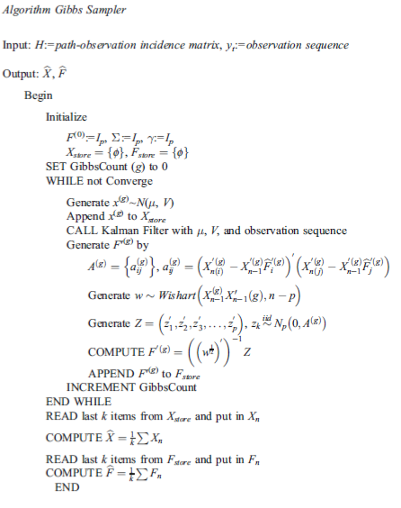
Parallel Implementation of the Algorithm
Gibbs sampler, requires tremendous iterations during computation
To achieve real-time information requirement, parallel computing technique is introduced to increase the performance. The solution algorithm should be modified to adopt the parallel implementation
Different random seed=>different solution chain
The chain in each computing part will then be gathered to check the convergence. In this situation, communication between computing nodes is minimum, and computing power can be easily increased without communication bandwidth limitation

Slide 13
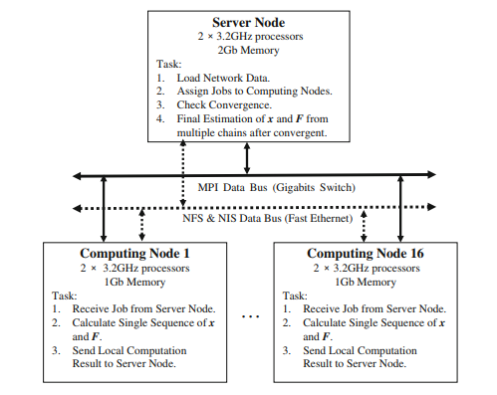
Parallel Architecture
Initialize the parameters used and the necessary input data. the server node
The computational procedure for the parallel process consists of:
Load input data and parameters. Initialize MPI environment.
Count the computing nodes exists in the cluster environment. Send data to each computing nodes.
Each computing nodes generate its own X and F' sequences by given input data. These results are sent to the server for convergence check.
The server check the convergence(R).
If R > 1.1, the computing nodes will continue step 3. otherwise, the server estimate the global X and F by sequences generated by computing nodes.
Stop MPI environment. Output data.

Slide 14
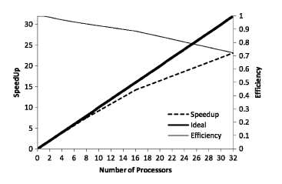
Speed ups and Efficiencies
The technique has been implemented on a part of a real network of the Taipei Mass Rapid Transit (MRT)
The technique has been implemented on a part of a real network of the Taipei Mass Rapid Transit (MRT)
the speedups is the ratio of the code execution time on a single processor to that on multiple processors and
efficiency is defined as the speedup divided by the number of processors

Slide 15
References:
A Kalman filter approach to dynamic OD flow estimation for urban road networks using multi-sensor data, by Zhenbo Lu , Wenming Rao, Yao-Jan Wu, Li Guo1 and Jingxin Xia(2014)
Estimation of origin-destination matrix from traffic counts: the state of the art, by Sharminda Bera 1 , K. V. Krishna Rao , Civil Engineering Department, IIT Bombay, India, 2011
Implementing A Dynamic O-D Estimation Algorithm within the Microscopic Traffic Simulator Paramics, California PATH Working Paper, UCB-ITS-PWP-2002-4 California Partners for Advanced Partners for Advanced Transit and Highways, Reinaldo C. Garcia University of California, Irvine (2002)
The Origin–Destination Matrix Estimation Problem — Analysis and Computations, Book by Anders Peterson (2007)
Time Dependent Origin-destination Estimation from Traffic Count without Prior Information, Hsun-Jung Cho & Yow-Jen Jou & Chien-Lun Lan (2008)

Slide 16
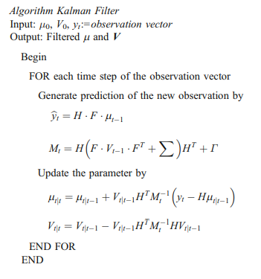
The algorithms

Slide 17
Parallel Architecture used
The technique has been implemented on a part of a real network of the Taipei Mass Rapid Transit (MRT)
The parallel environment of PC-cluster used consists :
16 computing nodes; each contains two processors equivalent to Intel XEON 3.2 GHz and 1 GB memory.
Nodes are connected with a Gigabits Ethernet switch for MPI protocol and a 100 Mbits PCI fast Ethernet switch for Network File System (NFS) and Network Information System (NIS).
For assigning jobs, the input data are sent to computing nodes in the cluster through TCP/IP base intranet with Message Passing Interface (MPI) Library through gigabit switch.

Slide 18
Multiple chain convergence of Gibbs Sampler
Single chain (sequence) methods hardly bring information on the regions of the space it does not visit. Parallel chain methods try to overcome such defect by generating parallel chains, aiming at eliminating the dependence on initial conditions.
The convergence control is most often based on the comparison of the estimations of different quantities for the parallel chains. More precisely, the criterion is based on the difference between a weighted estimator of variance for each chain and the variance of the estimators on the different chains.
The estimation method composed of two steps.
First, create an estimate of the target distribution, centered about its mode (or modes), and over-dispersed in the sense of being more variable than the target distribution. The approximate distribution is then used to start several independent chains of the iterative simulation.
The second step is to analyze the multiple chains to form a distributional estimate of the target random variable.
The monitor of convergence of the iterative simulation is to estimate the factor by which the scale of the current distribution for the target distribution might be reduced if the simulations werecontinued to the limit n→∞. This potential scale reduction can be estimated by…….
R declines to 1 as n→∞. ^ R is the ratio of the current variance estimate, ^ V, to the within-chain variance, W. Once ^ R is near 1, it is conclude that each set of the simulated values is close to the target distribution. In practice, the potential scale reduction is chosen to be 10% ^ R 1:1 . After it converges, we can calculate the desired sample value (the state vector) based on the empirical distribution of the n simulated iterates for each simulated chain

Slide 19
The Terminology: Gibbs Sampling
-a MCMC algorithm for obtaining a sequence of observations which are approximated from a specified multivariate probability distribution, when direct sampling is difficult.
This sequence can be used to approximate
the joint distribution (e.g., to generate a histogram of the distribution);
to approximate the marginal distribution of one of the variables, or some subset of the variables (for example, the unknown parameters or latent variables);
or to compute an integral (such as the expected value of one of the variables). Typically, some of the variables correspond to observations whose values are known, and hence do not need to be sampled.
Gibbs sampling is commonly used as a means of statistical inference, especially Bayesian inference. It is a randomized algorithm (i.e. an algorithm that makes use of random numbers), and is an alternative to deterministic algorithms for statistical inference such as the expectation-maximization algorithm (EM).
As with other MCMC algorithms, Gibbs sampling generates a Markov chain of samples, each of which is correlated with nearby samples. As a result, care must be taken if independent samples are desired. Generally, samples from the beginning of the chain (the burn-in period) may not accurately represent the desired distribution and are usually discarded. It has been shown, however, that using a longer chain instead (e.g. a chain that is n times as long as the initially considered chain using a thinning factor of n) leads to better estimates of the true posterior. Thus, thinning should only be applied when time or computer memory are restricted.
SOURCE: wiki

Slide 20
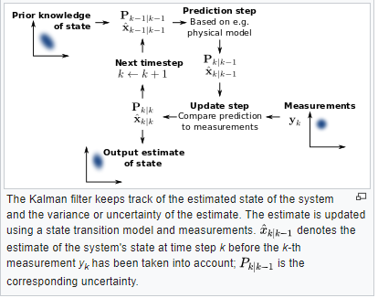
The Terminology: Kalman Filter OR Linear Quadratic Estimation
https://www.youtube.com/watch?v=CaCcOwJPytQ
For linear quadratic Gaussian problems
To estimate predicted values
To estimate a system state when it cannot be measured directly
Uses a series of measurements observed over time, containing statistical noise(+ other inaccuracies)
Produces estimates of unknown variables that tend to be more accurate than those based on a single measurement alone, by estimating a joint probab distn over the variables for each timeframe
The algorithm works in a two-step process.
In the prediction step, the Kalman filter produces estimates of the current state variables, along with their uncertainties.
Once the outcome of the next measurement (necessarily corrupted with some amount of error, including random noise) is observed, these estimates are updated using a weighted average, with more weight being given to estimates with higher certainty.
The algorithm is recursive. It can run in real time, using only the present input measurements and the previously calculated state and its uncertainty matrix; no additional past information is required.
Using a Kalman filter does not assume that the errors are Gaussian. However, the filter yields the exact conditional probability estimate in the special case that all errors are Gaussian

Slide 21
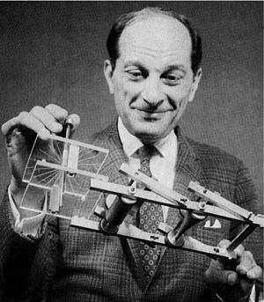
Stan Ulam Holding the FERMIAC
Late in the war, under the sponsorship of von Neumann, Frankel and Metropolis began to carry out calculations on the first general-purpose electronic computer, the ENIAC at the Aberdeen Proving Ground in Maryland. Shortly after returning to Los Alamos, Ulam participated in a review of results from these calculations.^{[33]} Earlier, while playing solitaire during his recovery from surgery, Ulam had thought about playing hundreds of games o estimate statistically the probability of a successful outcome.^{[34]} With ENIAC in mind, he realized that the availability of computers made such statistical methods very practical. John von Neumann immediately saw the significance of this insight. In March 1947 he proposed a statistical approach to the problem of neutron diffusion in fissionable material.^{[35]} Because Ulam had often mentioned his uncle, Michał Ulam, "who just had to go to Monte Carlo" to gamble, Metropolis dubbed the statistical approach "The Monte Carlo method".^{[33]} Metropolis and Ulam published the first unclassified paper on the Monte Carlo method in 1949.^{[36]}
Fermi, learning of Ulam's breakthrough, devised an analog computer known as the Monte Carlo trolley, later dubbed the FERMIAC. The device performed a mechanical simulation of random diffusion of neutrons. As computers improved in speed and programmability, these methods became more useful. In particular, many Monte Carlo calculations carried out on modern massively parallel supercomputers are embarrassingly parallel applications, whose results can be very accurate.^{[21]}
t

